Slide 1
Team 14
Sense-able Gym
Daniel DeHoog, T.J. DeVries, Paul Griffioen, Ryan Siekman

Slide 2
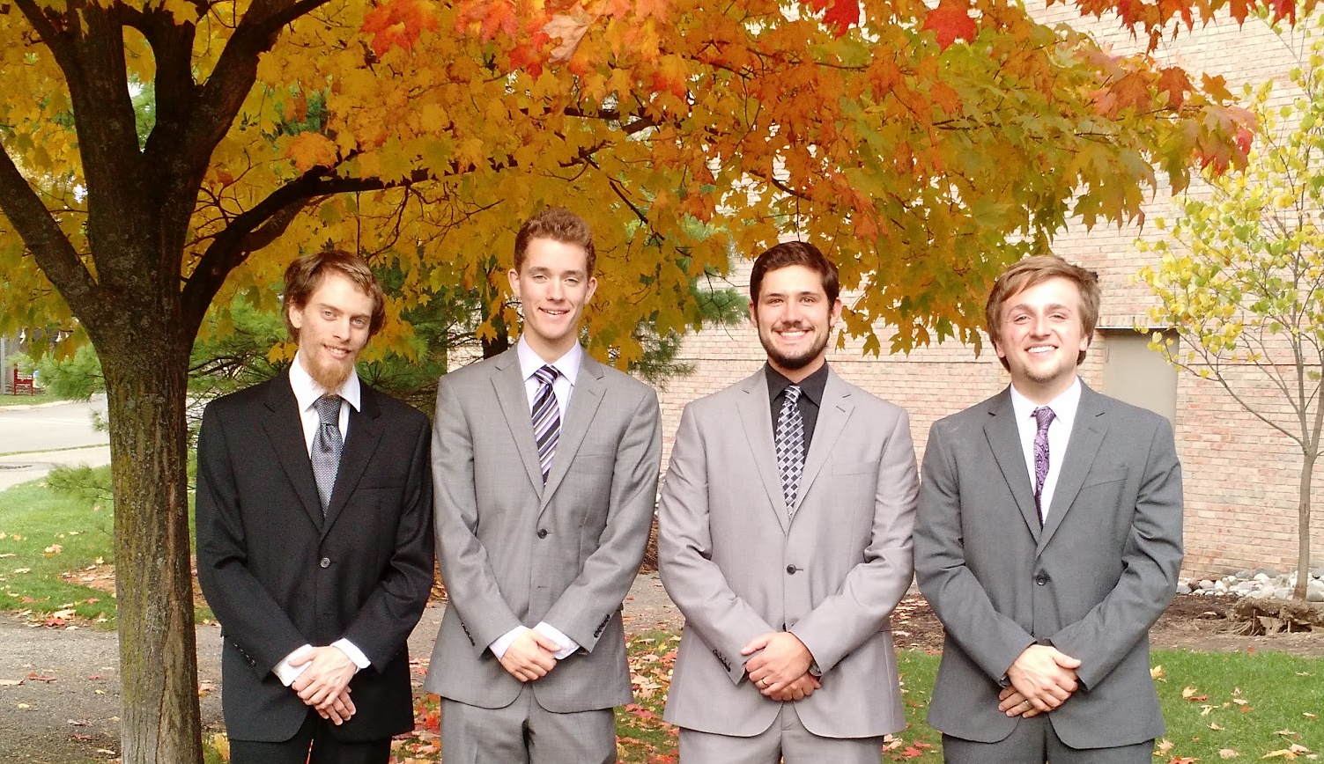
Team 14 Introduction
Daniel DeHoog | Paul Griffioen | Ryan Siekman | TJ DeVries
Problem
Project
Customer
Design Norms
Status

Slide 3
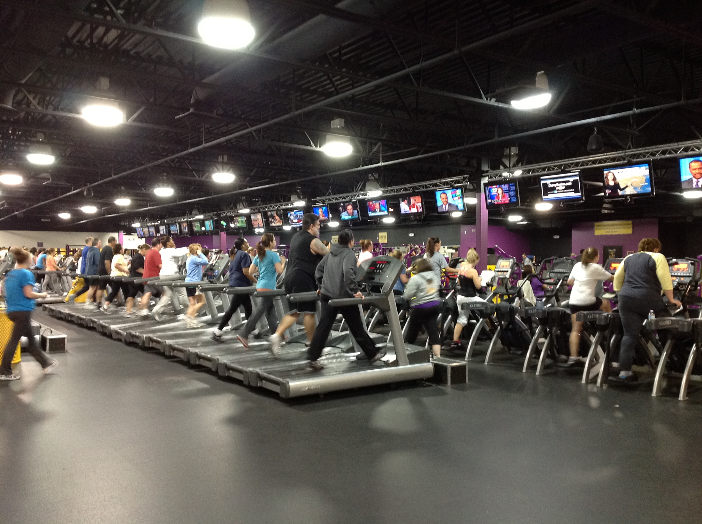
Problem
Figure 1: A Crowded Gym
Problem
Project
Customer
Design Norms
Status
Notes:
Gyms can be crowded
May not be any available equipment
Can’t check to see how busy it is before going
Gym owners don’t know how much use a particular piece of equipment gets

Slide 4
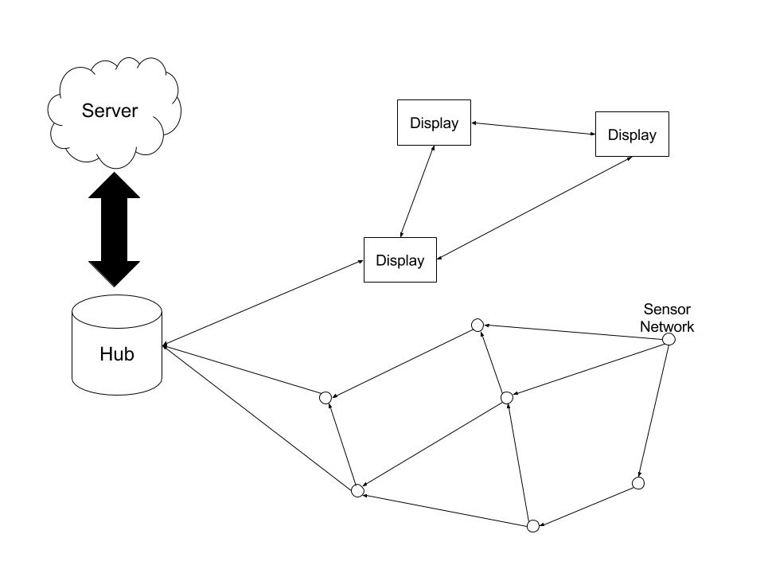
Project
Gym Reservation and Sensor Network
3 physical parts:
Sensors: Senses equipment use
Displays: Shows reservations
Hub: Collects data
Figure 2: An Example Sketch of the Prototype System
Problem
Project
Customer
Design Norms
Status

Slide 5
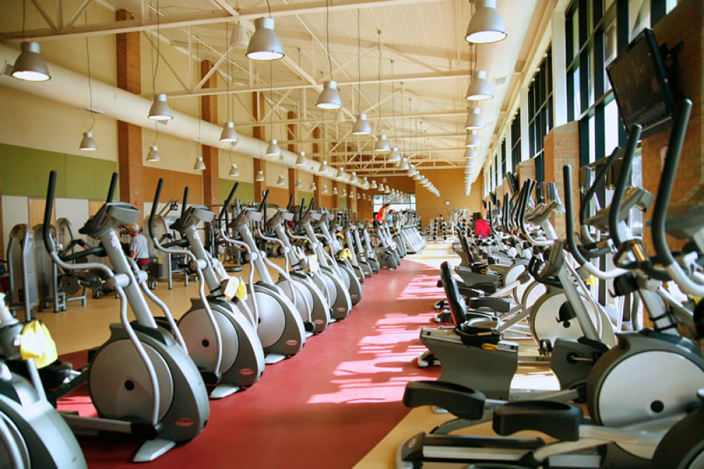
Project Competition
Current reservation systems are for rooms or trainers, not equipment
Any technology in current gym equipment is very expensive and doesn’t communicate with other systems.
Figure 3: An Example of Current Gym Equipment
Problem
Project
Customer
Design Norms
Status

Slide 6
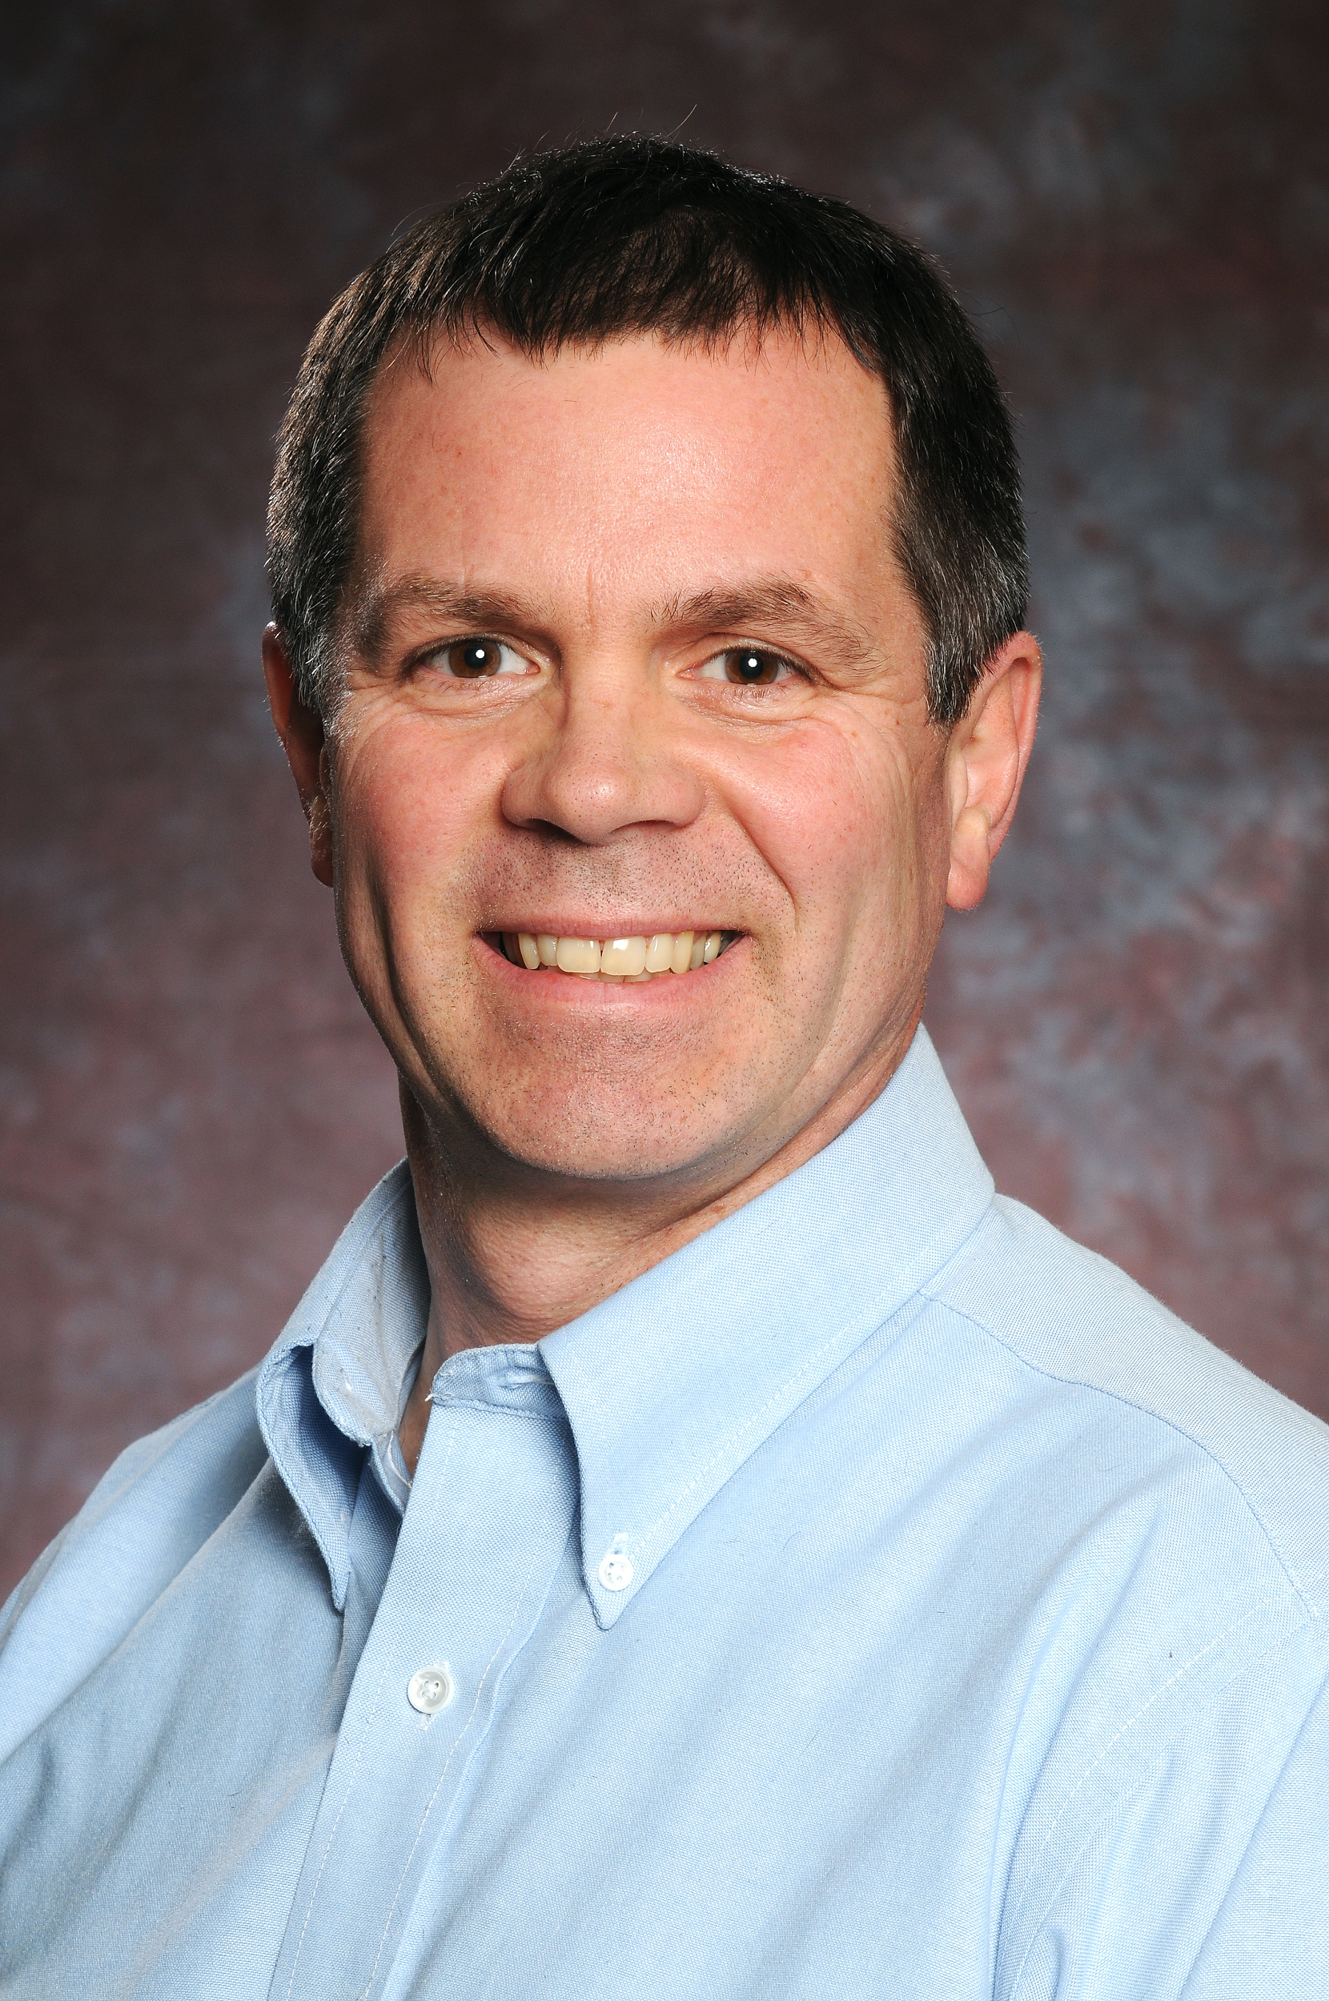
Customer
Present Customer
Mr. Roy Zuidema
Director of Campus Wellness
Future Customers
A private gym owner or manager
Figure 4: Roy Zuidema, A Potential Client
Problem
Project
Customer
Design Norms
Status

Slide 7
Design Norms
Delightful Harmony
Transparency
Trust
Stewardship
Problem
Project
Customer
Design Norms
Status
Notes:
Transparency
We intend to be upfront with what happens to the customer’s data, if they sign on for a personal plan
Stewardship
We intend to provide the management staff with the tools to analyze gym usage
Trust
We intend to keep the customer’s information secure
We intend to give a dependable and reliable experience to the customer
Delightful Harmony
We intend to make our system a joy to use
encouraging them to go to them gym, which promotes the human value of health and a complete existence.

Slide 8
Status
Research
Hardware platforms for each section of the system
Communication Protocols
Communication with Customer
We have had one meeting with Roy Zuidema
Plan on meeting with him again
Problem
Project
Customer
Design Norms
Status
Notes:
Delightful harmony could also talk about how it is encouraging them to go to them gym, which promotes the human value of health and a complete existence.

Slide 9
Bibliography
Figure 1: https://fitnesswayne.files.wordpress.com
Figure 2: Ryan Siekman
Figure 3: https://www.calvin.edu
Figure 4: https://www.calvin.edu

Slide 10
Any Questions?

